Slide 1
HOUSE PRICING PREDICTION MODEL
PYTHON PROJECT IN FULFILLMENT OF MAT 271 BY 21-2157

Slide 2
LIBRARIES AND DATA SETS USED
Numpy imported as np
Pandas imported as pd
Matplotlib.pyplot imported as plt
%matplot lib inline
Sklearn.linear_model to import linear regression
sklearn.model_selection to import train_test_split

Slide 3
DATA SET
The data set consisted of :
1.Baths where ½ a bath represents a sink and toilet while a full bath is inclusive of a shower.
2.Beds
3.House size in sqft
4.Lot size (size of entire compound) in sqft
5. Zip code
6. House price in dollars

Slide 4
STEP 1: IMPORTING THE DATA SET
The data set was obtained from Kaggle.com and it is from houses in boston.
The machine reads in the data once imported and using the function “data.describe()” it is able to find the count, mean ,standard deviation and the maximum and minimum

Slide 5
STEP2:DATA ANALYSIS
Here,we try to compare different aspects of the data to price in an attempt to draw relationships between them.
Different mathematical methods are employed to graphically deduce the relationship of the data sets

Slide 6
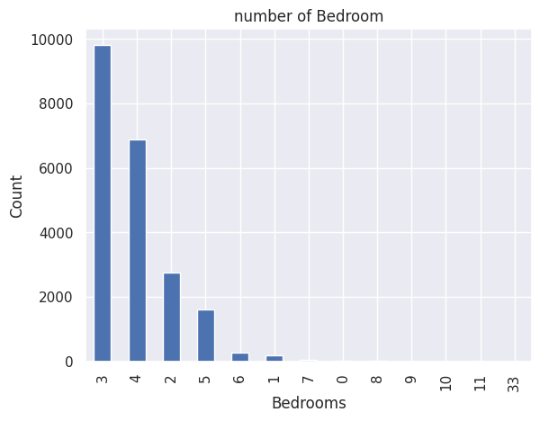
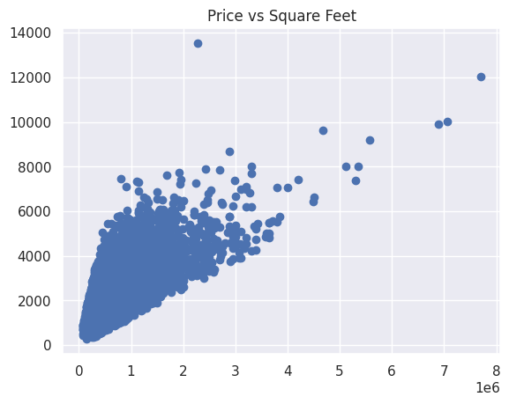
VARIOUS COMPARISONS MADE
function seaborn.utils.despine(fig=None, ax=None, top=True, right=True, left=False, bottom=False, offset=None, trim=False)>

Slide 7
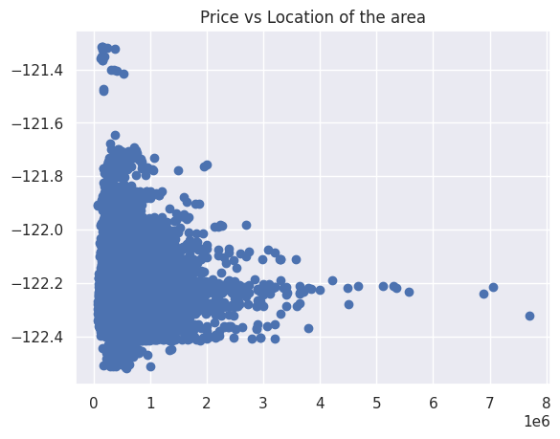
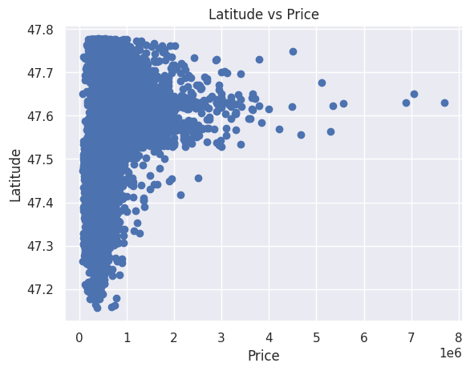

Slide 8
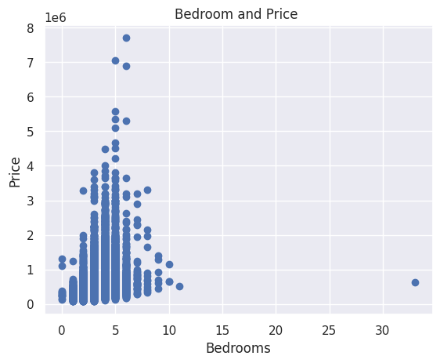
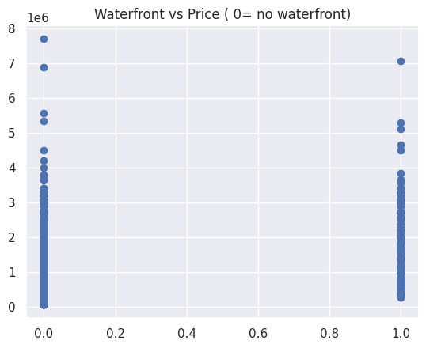

Slide 9
INTRODUCING LINEAR REGRESSION MODEL
We first have to split our data into the train data and the test data.
This method is used to measure the accuracy of your model,
It works by using 80% of the data for training and 20% for testing.
It is imported from sklearn.model selection

Slide 10
We then fit the linear regression model onto it and we obtain the accuracy scale.
An accuracy of 85% and above is considered good whereas anything below it is considered unreliable.
Our data set gave an accuracy level of 73%, this can be attributed to the following
.Data read by machine may have been lost

Slide 11
.The machine may require a decision tree
.The machine requires more time to internalize the data
The accuracy can be fixed using gradient descent boosting.

Slide 12
THE END

